Slide 1
IBM Capstone Project
Battle of Neighborhoods Paris Vs Manhattan
Cluster analysis of Neighborhoods similarities

Slide 2
Problem Statement
A travel booking websites wants to help their potential customers understand the similarities/dis-similarities between New Your and Paris so that the customers can understand and make informed decision to choose their holiday destination.

Slide 3
Solution
We will build the clustering model. After clustering the data we will try to identify possible similarities in clusters of venues between Paris and Manhattan. For this we will use the k-Means method provided by Scikit-Learn Machine Learning library.
We will achieve this by following the below steps :::::
A. First we will explore each neighborhood from Paris and Manhattan. We will consider 10 categories of venues for each arrondissement from Paris and neighborhood from Manhattan
B. We will cluster the venues from Paris and Manhattan and then visualize them in on a map separately.
C. Fit the data with the k-Means model
D. Visualize the clusters on the city Paris and Manhattan maps

Slide 4
Data Points – Paris
Paris and New York Geographical Data
Paris geographical data
The city of Paris is divided into twenty arrondissements municipaux, administrative districts, more simply referred to as arrondissements. These are not to be confused with departmental arrondissements, which subdivide the 100 French départements. The word "arrondissement", when applied to Paris, refers almost always to the municipal arrondissements listed below. The number of the arrondissement is indicated by the last two digits in most Parisian postal codes (75001 up to 75020).
The twenty arrondissements are arranged in the form of a clockwise spiral (often likened to a snail shell), starting from the middle of the city, with the first on the Right Bank (north bank) of the Seine. Lyon and Marseille have, more recently, also been subdivided into arrondissements.
https://en.wikipedia.org/wiki/Arrondissements_of_Paris

Slide 5
Data Points – New York
New York geographical data
New York Neighborhood has a total of 5 boroughs and 306 neighborhoods. In order to segment the neighborhoods and explore them, we will essentially need a dataset that contains the 5 boroughs and the neighborhoods that exist in each borough as well as the the latitude and longitude coordinates of each neighborhood.
Luckily, this dataset exists for free on the web, here is the link to the dataset: https://geo.nyu.edu/catalog/nyu_2451_34572
For our convenience, I will simply use the file that is already placed on the IBM server, so we can simply run a wget command and access the data.

Slide 6
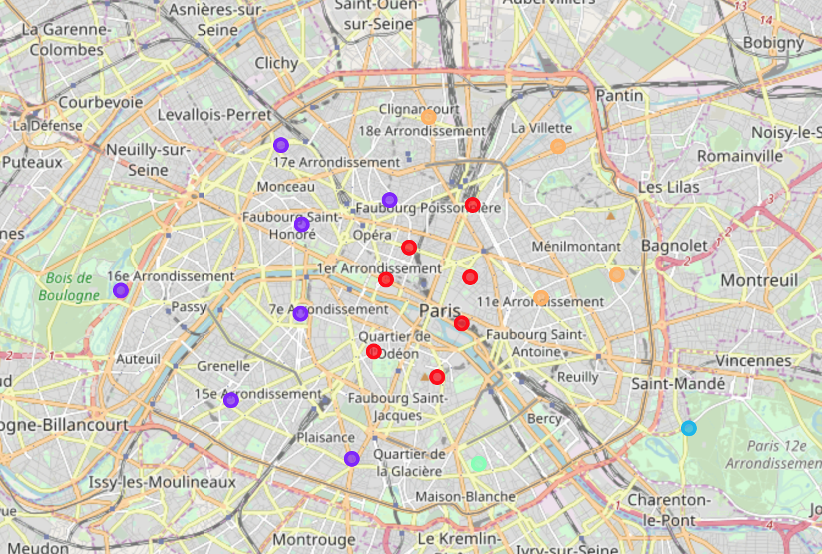
Paris Neighborhoods Clusters

Slide 7
Color Coding of Neighborhoods - Paris
We have five clusters in Paris with two of them (2 and 3) having only 1 neighborhood.
Below is the color coding from the above image:
Cluster 0 – Red
Cluster 1 – Purple
Cluster 2 - Light Blue
Cluster 3 - Light Green
Cluster 4 - Orange

Slide 8
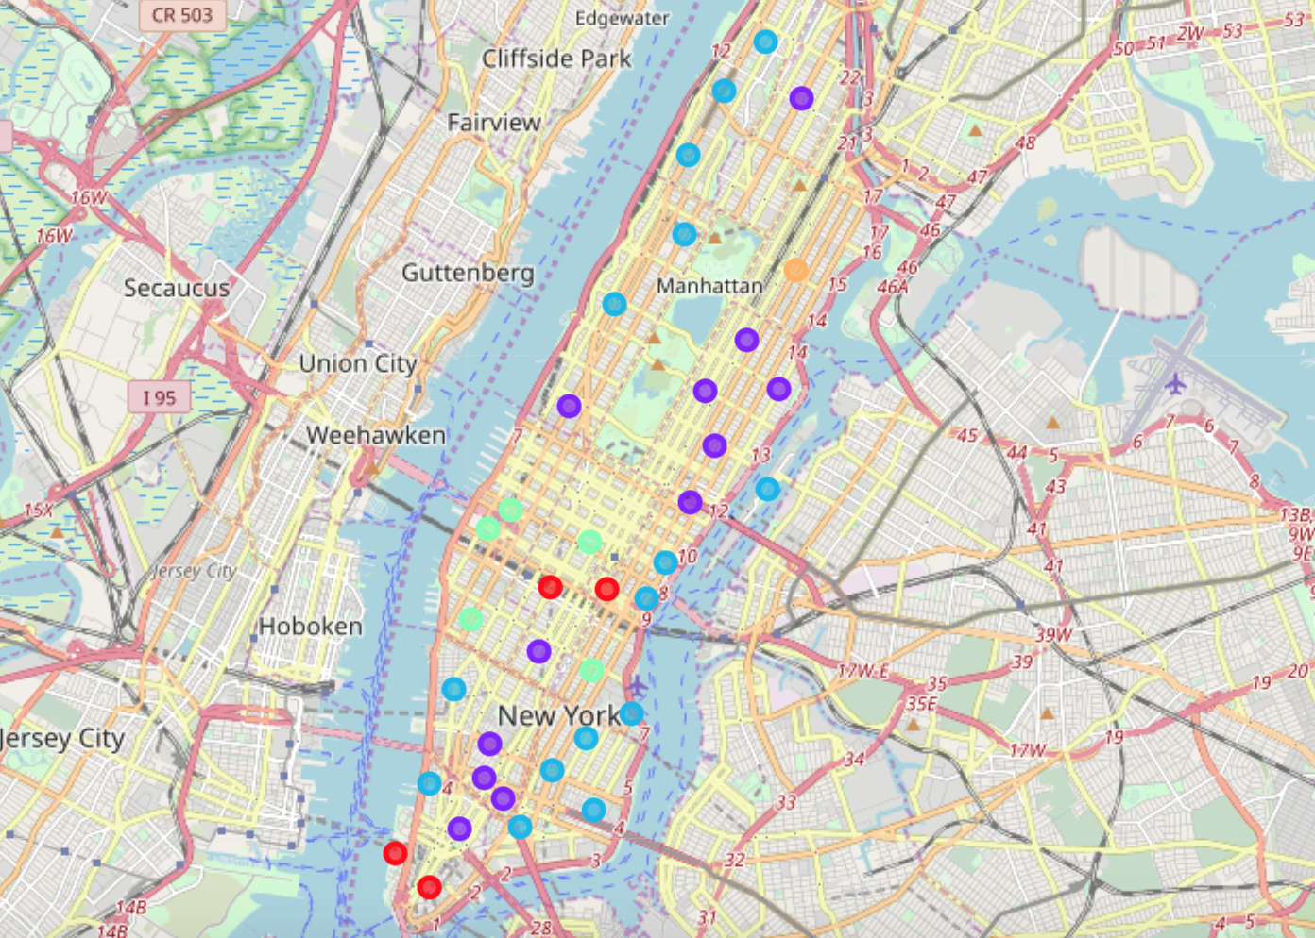
Manhattan Neighborhoods Clusters

Slide 9
Color Coding of Neighborhoods - Manhattan
We have five clusters in Manhattan.
Below is the color coding from the above image:
Cluster 0 – Red
Cluster 1 – Purple
Cluster 2 - Light Blue
Cluster 3 - Light Green
Cluster 4 - Orange

Slide 10
Conclusion
In this report, we tried to find the similarities between the neighborhoods of Paris and Manhattan using Foursquare venues recommendations data. We have only used rates of venues listed in neighborhoods for comparison. When evaluating against ground truth data, we found that there are many similarities between clusters found in Paris and Manhattan.
Tourists will find Paris and Manhattan as good attractions and plan confidently visiting the places.
The travel booking site can provide these similarities and finding to the potential tourists and help them make the booking confidently.

